Slide 1
Sustainable?
Dr. Robert A Perkins, PE
Civil and Environmental Engineering
University of Alaska Fairbanks

Slide 2
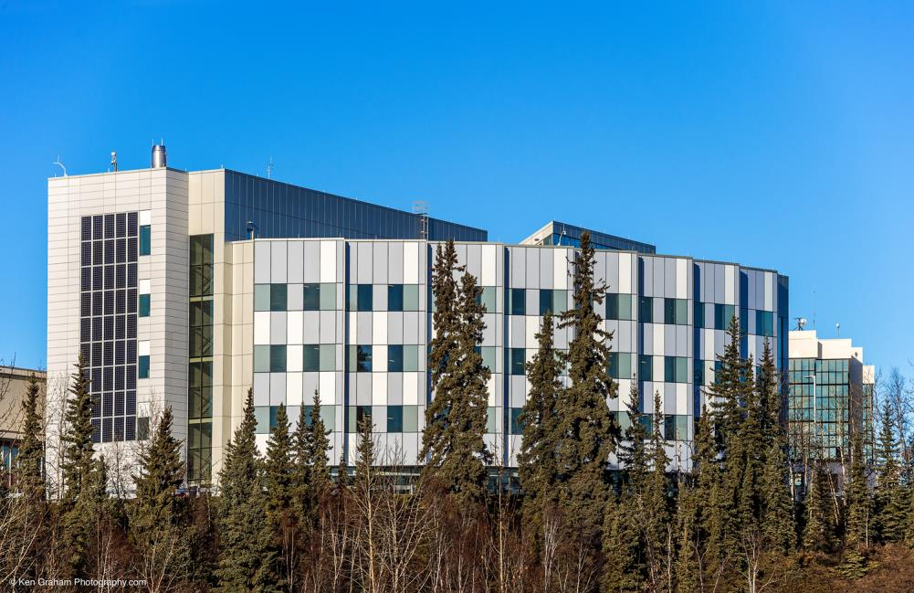
UAF Engineering
University of Alaska Fairbanks
Inspiring discovery. Inspiring greatness. Inspiring, naturally.

Slide 3
Sustainable?
ABET Teaching Outcome: …ability to design a system, …within realistic constraints such as ….sustainability.
ASCE Ethics: Engineers shall hold paramount the safety, health and welfare of the public and shall strive to comply with the principles of sustainable development in the performance of their professional duties.
Notes:
(c) an ability to design a system, component, or process to meet desired needs within realistic constraints such as economic, environmental, social, political, ethical, health and safety, manufacturability, and sustainability
b. ASCE code of ethics1. Fundamental Canons Engineers shall hold paramount the safety, health and welfare of the public and shall strive to comply with the principles of sustainable development3 in the performance of their professional duties. (3 In October 2009, the ASCE Board of Direction adopted the following definition of Sustainable Development: “Sustainable Development is the process of applying natural, human, and economic resources to enhance the safety, welfare, and quality of life for all of the society while maintaining the availability of the remaining natural resources.”)

Slide 4
Sustainable Development is the process of applying natural, human, and economic resources to enhance the safety, welfare, and quality of life for all of the society while maintaining the availability of the remaining natural resources
Three dimensions : the economy, the environment, and society. (People, Profit, Planet)

Slide 5
Sustainable Construction
Most projects, social and economic dimensions have been treated by the owner and designer well before construction starts.
Environmental might be influenced during construction.
Environmentally responsible methods for conducting field construction and maintenance operations in cold regions.
Notes:
A sustainable construction project would be one for which there is a balance among present and future needs.
For this project we confine our consideration to environmental sustainability while recognizing the importance of the other two aspects, since they become more important later in the projects life-cycle.
Sustainable construction involves “creating construction items using best-practice clean and resource-efficient techniques from the extraction of the raw materials to the demolition and disposal of its components.” (Yates, 2014)
Here we focus on environmentally responsible methods for conducting field construction and maintenance operations in remote cold regions.

Slide 6
Put in Plans and Permits?
“Why not in the spec’s?”
Depend on details of contractor’s operations that owner and engineer traditionally avoid – and should.
Not subject of permits - below agency radar?
Optional methods
Off the ROW

Slide 7
Value to Contractor
CSR, Corporate Social Responsibility,
owners and major contractors
or sub to major contractors
Proactive approach is good “PR”
Local residents and many workers respect environment and local resources: hunting and fishing

Slide 8
QBS, criteria
Certifications
Citations, good and bad
Financial
Value Engineering
New methods may save money

Slide 9
Interviews
CESTiCC
Alaska Construction People were very interested
Had many good ideas

